Slide 1

Expansion Engineering of Bikes Chicago
Nino orton-Clarke & Tomos Rands

Slide 2
Overview
What we did
Key Stats
New Stations/extensions
Costs

Slide 3
What We Did
How was the data collected
Analysed data to see which stations are used the most
Looked at the areas the stations were in
Decided on where the new stations should be

Slide 4
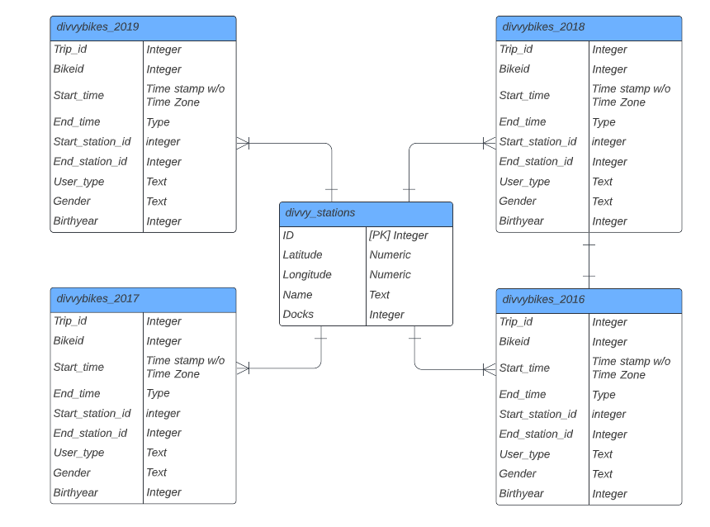
Entity Relationship Model

Slide 5
Data Dictionary
Field Name | Data Type | Data Format | Field Size | Description | Example
ID | Integer | N | - | Unique ID for all Divvy Stations | 35
Latitude | Numeric | N | 20 | Latitude of Divvy Station | 41.892278
Longitude | Numeric | N | 20 | Longitude of Divvy Station | -87.612043
Name | Text | - | 50 | Name of Divvy Station | Streeter Dr & Grand Ave
Docks | Integer | N | - | Number of Docks at Divvy Station | 46
Trip ID | Integer | N | - | Unique ID for all Trips | 8547968
Bike ID | Integer | N | - | Unique ID for all Bikes | 728
Start Time | Timestamp with Time Zone | YYYY-MM-DD HH:MM:SS+TZ | XXXX-XX-XX XX:XX:XX+XX | Time at Start of Trips | 2016-01-01 15:29:00+00
End Time | Timestamp with Time Zone | YYYY-MM-DD HH:MM:SS+TZ | XXXX-XX-XX XX:XX:XX+XX | Time at End of Trips | 2016-01-01 15:36:00+00
User Type | Text | Subscriber/Customer | 10 | Is the User a Subscriber or Customer? | Subscriber
Gender | Text | Male/Female | 6 | Gender of User | Male
Birth Year | Integer | YYYY | 4 | Birth Year of User | 1988

Slide 6
Top 5 used Divvy Stations in 2016

Slide 7
Top 5 used Divvy Stations in 2017

Slide 8
Top 5 used Divvy Stations in 2018

Slide 9
Top 5 used Divvy Stations in 2019

Slide 10
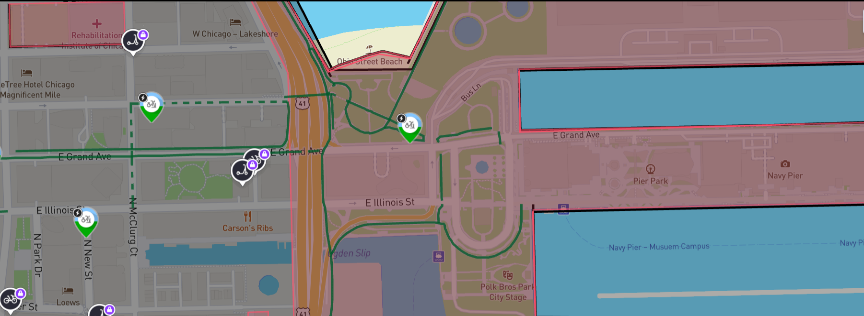
1st New Station – Lakefront Trail Connector
Streeter Dr. & Grand Ave.
Adjacent to Streeter Dr. & Grand Ave. Docking station.
Abundance of restaurants, bars, rides and general tourist attractions.
Navy pier attracts ~ 9 million visitors per year.
Suggest installing a 15-dock station to help increase the supply for this area.
This would cost $6,690 to build and run for a year
Lakefront Trail Connector
Navy Pier

Slide 11
Uses per Dock 2019

Slide 12
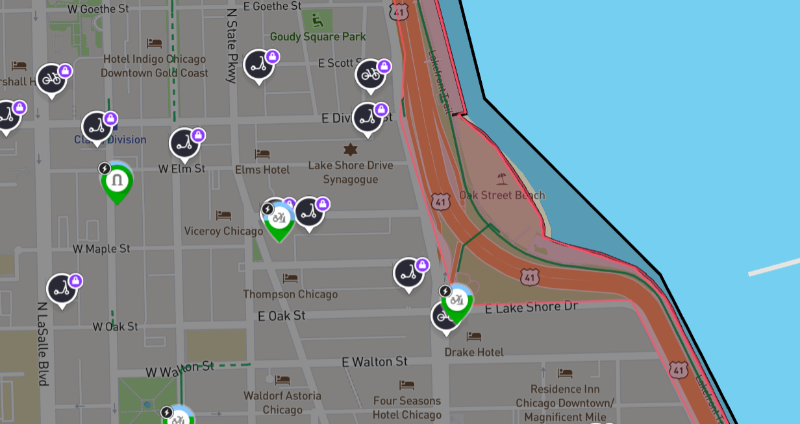
Extended Station – Michigan Ave. & Oak St.
Located by popular Oak St. Beach which drives the highest usage per dock rates from 2019.
Only has 22 docks, other stations with similar usage rates have between 30-40 docks.
Recommend initially increasing the number of docks to 30
Would cost $3,568 to build and run for a year
Oak St. Beach
Michigan Ave. & Oak St.

Slide 13
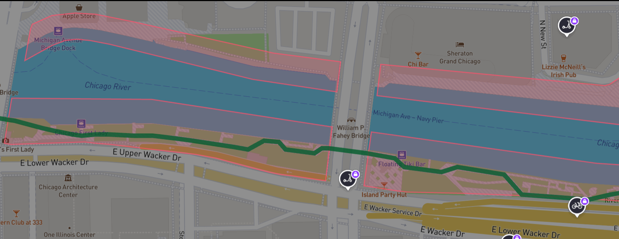
2nd New Station – Chicago Riverwalk
The Riverwalk is one of Chicago's biggest tourist destinations.
Has no docking stations along the riverwalk, despite having a bike lane along the southern bank.
Suggest installing a station just west of the William P Fahey bridge with 15 docks.
Hope to encourage pedestrians to use Divvybikes to explore the riverwalk.
Would cost $6,690 to build and run for a year
Proposed Location

Slide 14
Cost Evaluation
- Per trip - $1 to unlock the bike, $0.39/min
- Average use time in 2018-2019 – 24mins - $10.36
- $4,500 15 bike dock station
- $2,400 8 bike dock station
- $0.40 cost per bike per day
- $146 per year
- $2,190 to run 15 bikes for a year
- $1,168 to run 8 bikes for a year
- 15 bike station – 650 uses in a year ($6,690)
- 8 bike station – 350 uses in a year ($3,568)

Slide 15
Summary
Suggestions:
15-dock bike station to be installed near Streeter Dr. & Grand Ave. on Lakefront Trail Connector to increase supply in a busy area.
Extend Michigan Ave. & Oak St. from 22 to 30 docks to cope with the high usage per dock rates.
Install another 15-dock station along the Chicago Riverwalk to take advantage of the high footfall and cycle lane.

Slide 16
Thanks for listening
ANY QUESTIONS?

